Slide 1


Cyclist Bike Share Analysis
File created on: 6/16/2023 5:49:19 PM

Slide 2
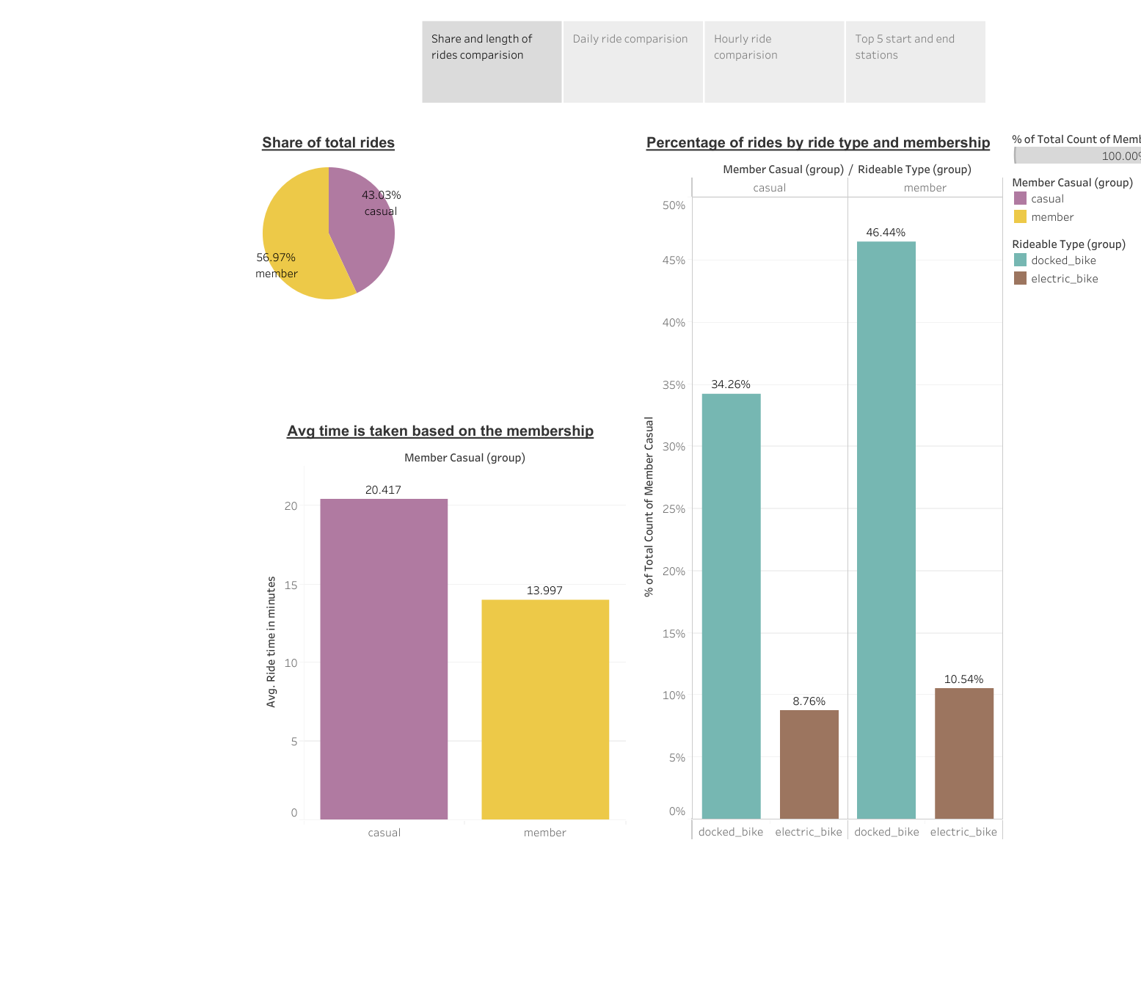
Share and Length of ride comparison

Slide 3
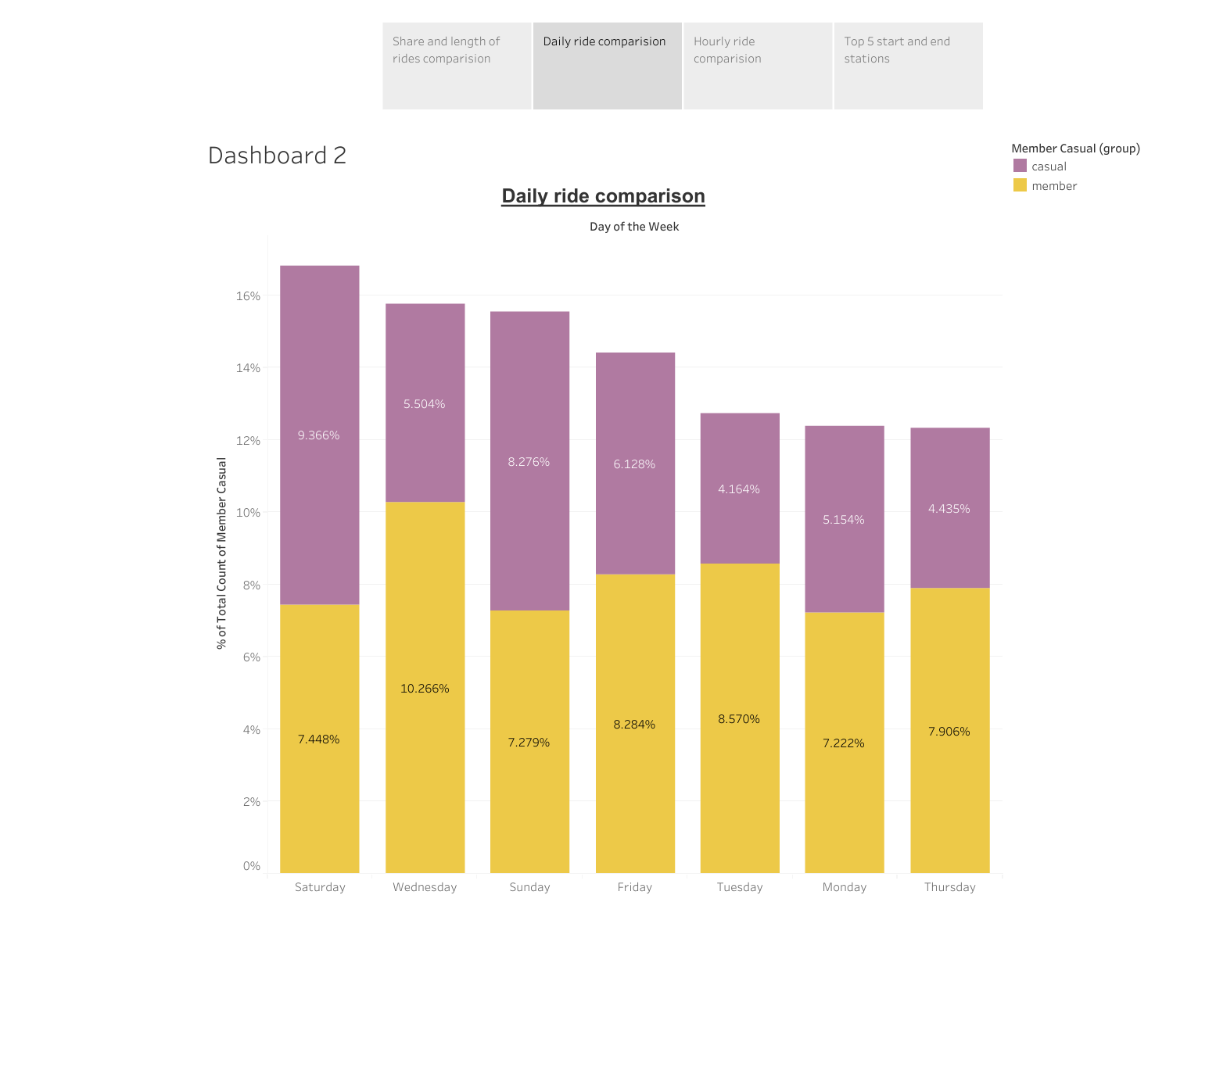
Daily ride comparison

Slide 4
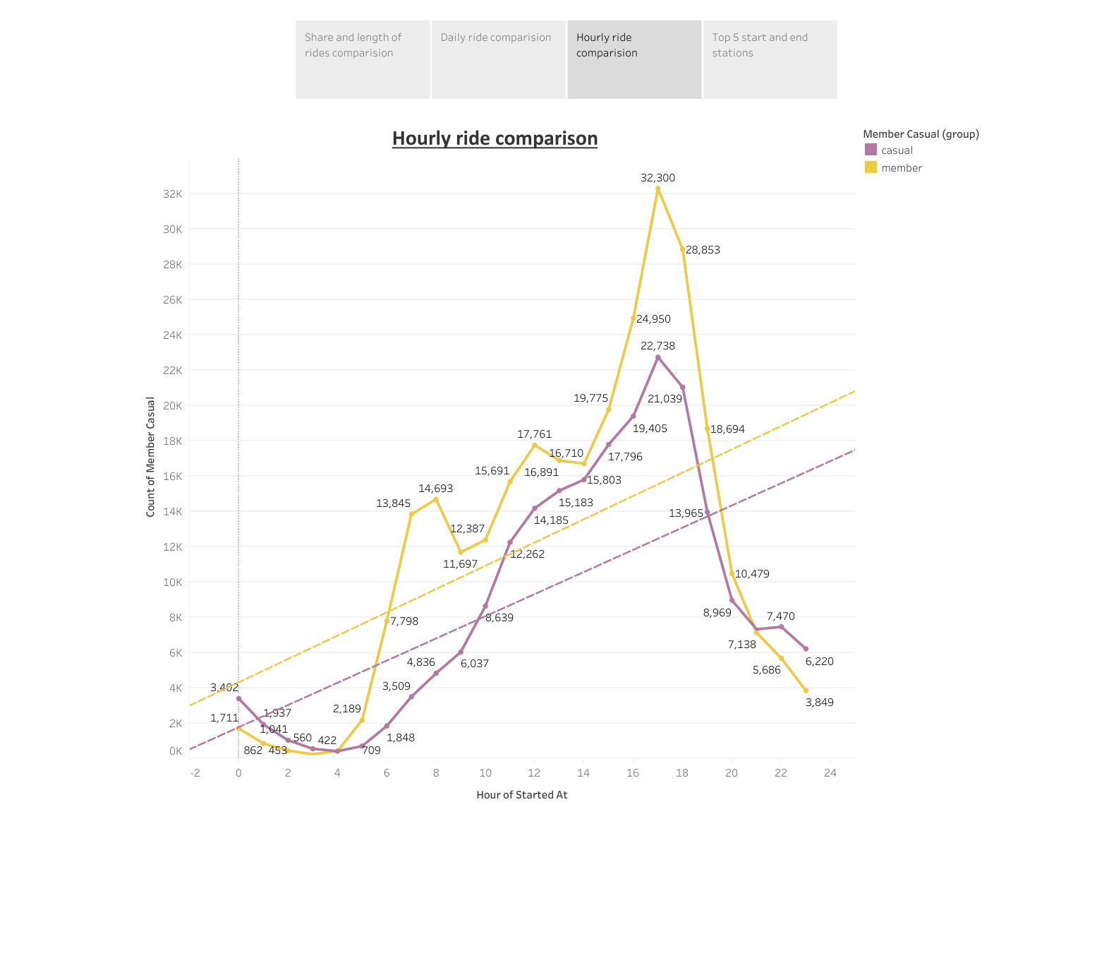
Hourly ride comparison

Slide 5
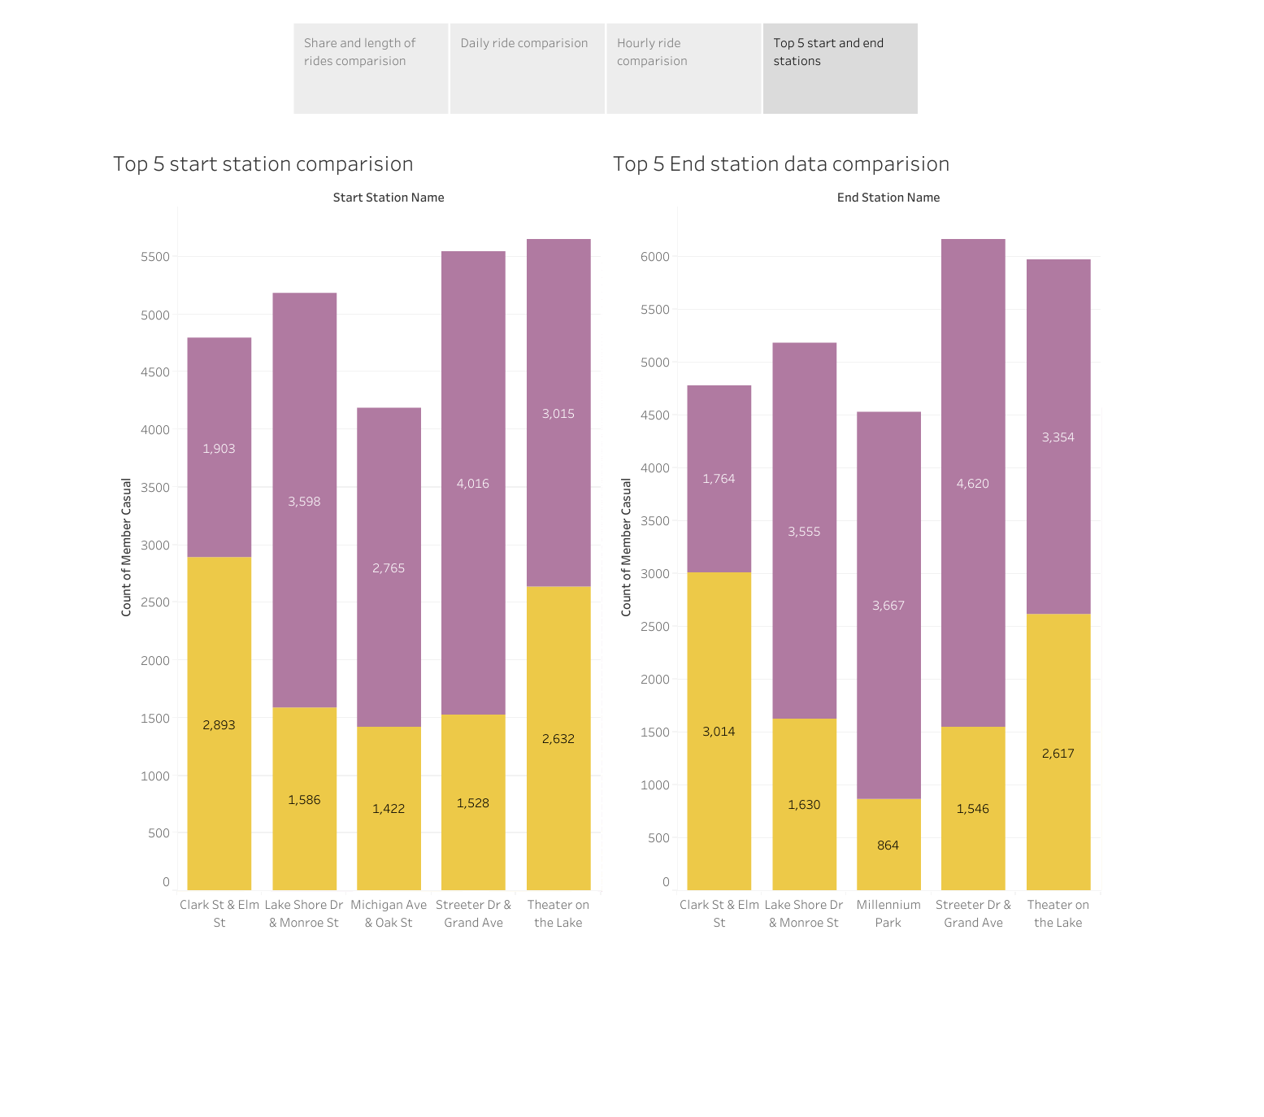
Top 5 Start and End stations

